Slide 1
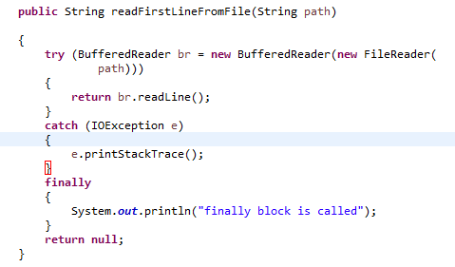
The try-with-resources Statement
A try-with-resources statement can have catch and finally blocks just like an ordinary try statement. In a try-with-resources statement, any catch or finally block is run after the resources declared have been closed.

